Slide 1
ADVANCED SKIN DISEASES DIAGNOSIS LEVEARGING IMAGE PROCESSING
PRESENTED BY
ABHIJEET ANIL WABLE
ARIGALA JAGADEESH
BAIG MANZOOR
BHARATHI KODURU
HARIPRIYA CHANDUPATLA
MENTOR
SANGEETHA MAHALINGAM

Slide 2
PROBLEM STATEMENT
Skin diseases are a widespread health issue, particularly in densely populated and polluted areas, where environmental stressors like air pollution exacerbate their prevalence. These conditions, including rosacea, melanoma, psoriasis, and acne, significantly affect individuals’ physical and mental well-being.
Addressing this challenge necessitates innovative, efficient, and accurate diagnostic tools to complement traditional methods, which often rely on dermatological expertise and invasive procedures
This project presents a cutting-edge system for diagnosing skin diseases using image processing and machine learning techniques. The methodology involves preprocessing steps such as noise filtering, grayscale conversion, and image segmentation to prepare high-resolution skin images for analysis.

Slide 3
OBJECTIVE
The objective of this project is to develop an efficient and accurate automated skin disease classification system by leveraging advanced image processing techniques and machine learning algorithms.
To classify various skin diseases, such as Athlete's Foot, Cellulitis, Chickenpox, and others, with a high degree of accuracy.
To utilize MobileNet, a lightweight and efficient deep learning model, for extracting meaningful and discriminative features from medical images of skin diseases.

Slide 4
FLOW CHART
Load and Preprocess Dataset
Select Features and Target
Data Splitting
Test a Random Image
Train SVM Model
Test the Model
Evaluate Model Performance

Slide 5
Preprocessing of Skin Disease Images :
Input medical images are preprocessed for consistency
Ensures compatibility with MobileNet’s input layer.
Feature Extraction Using MobileNet :
Pre-trained MobileNet is used as a feature extractor.
Remove the classification head (fully connected layers).
Extract deep feature embeddings from the penultimate layer.
Feature Representation :
MobileNet outputs a fixed-size feature vector for each image.
These vectors capture essential patterns like textures, colors, and edges, critical for identifying skin conditions.
Classification Using Support Vector Machine (SVM) :
Deep feature vectors are passed to an SVM classifier.
SVM is trained to classify diseases into categories
Uses a linear for high-dimensional separation.

Slide 6
DATASET
Multiple Skin Disease Detection and Classification Dataset contains eight different classes of skin diseases or conditions, which includes:
cellulitis
shingles
chickenpox
cutaneous-larva-migrans
ringworm
nail-fungus
athlete-foot
impetigo

Slide 7
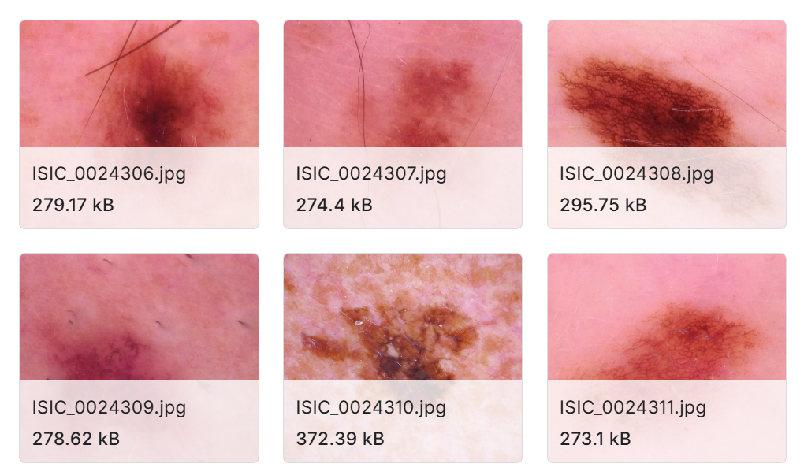
SKIN DISEASE IMAGES

Slide 8
MOBILENET WITH SVM
Advantages of MobileNet with SVM
Efficient and Lightweight:
MobileNet is optimized for performance on devices with limited computational power.
Robust Feature Extraction:
Pre-trained MobileNet learns general image patterns that can transfer well to medical images.
SVM’s High Precision for Small Datasets:
SVM performs well even when the dataset size is relatively small, leveraging high-quality features from MobileNet.

Slide 9
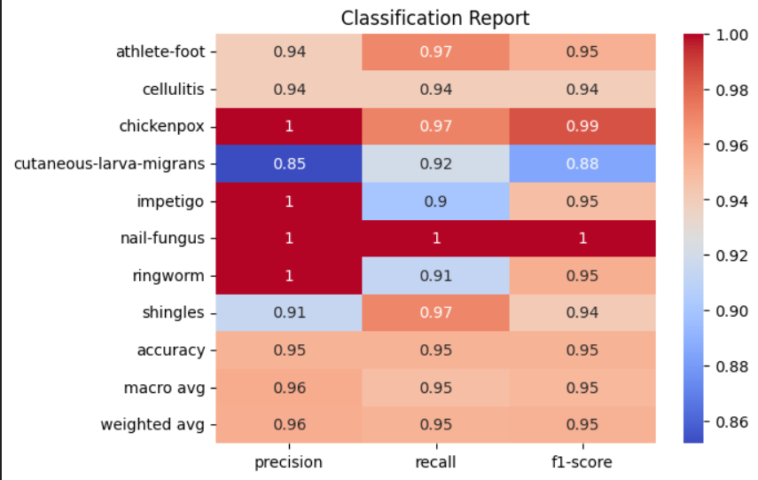
RESULTS

Slide 10
The classification model demonstrates an overall accuracy of 95%, indicating reliable performance in predicting skin conditions
The macro avg precision, recall, and F1-score of 0.96, 0.95, and 0.95, respectively, as indicators of balanced performance across all classes.
Class-wise Performance:
Chickenpox, Nail-fungus, Ringworm are got perfect scores whose Precision, Recall, and F1-Score = 1.0
Slightly Lower Performance:
Cutaneous-larva-migrans:
Precision: 0.85, Recall: 0.92, F1-Score: 0.88
Impetigo:
Recall: 0.9

Slide 11
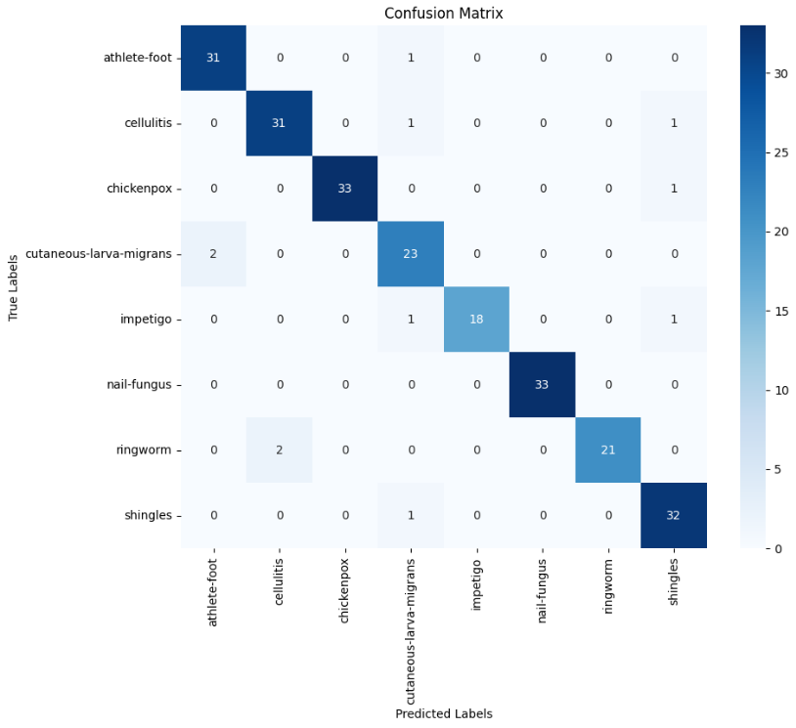

Slide 12
The values along the diagonal represent the number of correct predictions for each class.
These values indicate the true positive count for each skin disease category.
The off-diagonal values (non-zero entries not on the diagonal) represent the misclassifications.
Cutaneous-Larva-Migrans: 2 instances were incorrectly predicted as Athlete’s Foot
Ringworm: 2 instances were misclassified as Cellulitis.
Shingles: 1 instance was predicted as Cutaneous-Larva-Migrans.

Slide 13
REFERENCES
Enhanced MobileNet for skin cancer image classification with fused spatial channel attention mechanism: https://www.researchgate.net/publication/386022496_Enhanced_MobileNet_for_skin_cancer_image_classification_with_fused_spatial_channel_attention_mechanism This study proposes a novel deep learning model that enhances MobileNet for discriminating clinical skin cancer images by incorporating fused features.
A Smartphone-Based Skin Disease Classification Using MobileNet CNN:
https://www.researchgate.net/publication/336982075_A_Smartphone-Based_Skin_Disease_Classification_Using_MobileNet_CNN This paper discusses the use of the MobileNet model, applying transfer learning on seven skin diseases to create a skin disease classification system on an Android application.

Slide 14
CONCLUSION
The combination of MobileNet for feature extraction and SVM for classification achieved an accuracy of 95%, demonstrating its effectiveness in diagnosing advanced skin diseases. This approach leverages deep feature embeddings, resulting in near-perfect classification for diseases with distinct visual characteristics, such as Nail Fungus and Chickenpox.
Despite the high accuracy, slight challenges were observed in differentiating overlapping classes, such as Cutaneous-Larva-Migrans. This highlights areas for further optimization through fine-tuning and enhanced feature extraction. Overall, the method showcases the potential of integrating deep learning and machine learning for medical image analysis.

Slide 15


